Slide 1


Enhanced Weather Forecaster
Jason C. Jiang

Slide 2
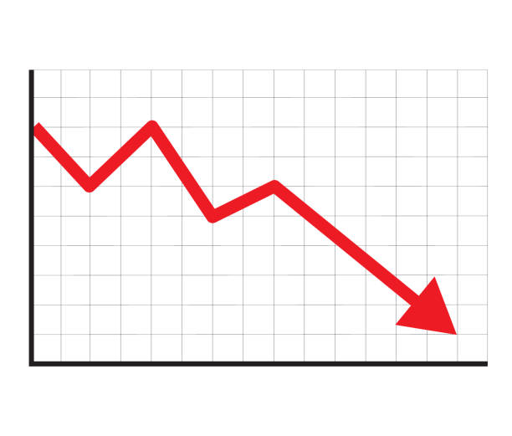
The Problem at Hand
Current weather forecaster for Mainland Europe has lost accuracy in its predictions.
Despite more and more data being inputted into the model, the accuracy of the model does not improve.
Notes:
The current weather forecaster for Mainland Europe has been out of date for quite some years now. The prediction metrics do not seem to be updating and the accuracy has slowly fallen over time. Even more is that despite the influx of new data and different data measurements, they are not being translated into better predictions.

Slide 3



Solution to Problem:
A Brand New Model
A new model can fix the problem of the existing model’s accuracy as inability to learn from new data.
Notes:
A solution: ditch the current model and rebuild it from the ground up. If the old model is unable to learn from new data, then the entire thing needs to be scrapped and replaced. Create a new model that can both predict more accurately and also be able to improve when given new data. For now in the scope of this problem, the new model will only predict average temperature, if it is proven to be good enough, it can be expanded to predict other weather values.

Slide 4
Imagine This… Heatwave in London
Predicted temperature - 28°C
Turns out to be a significant underestimate
City underestimates cooling demand
Power grid becomes strained
Rolling blackouts occur
A heatwave is approaching London and currently the old weather model is being used.

Slide 5
Alternatively…
Predicted temperature - 34°C
Ends up to be very accurate
Utility companies and hospitals are prepared with extra supplies and cooling units
Early warnings issued by city of London
Millions saved in energy overuse, hospitalizations, and emergency shutdowns
The new model is implemented just before the incoming heatwave in London

Slide 6
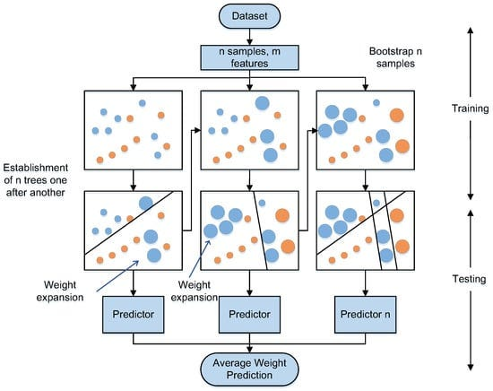
New Model Overview
The new model is based off of the categorical boosting technique to train a model on a training set
The model first constructs a decision tree
The decision tree is evaluated for amount of errors it made
Create a new decision tree to correct the errors made by the previous tree
Repeat this process until x iterations have passed
Final result is an ensemble of trees that work together to provide an accurate prediction
Notes:
The new model is based on categorical boosting, or CatBoost, which itself is based off of the gradient boosting methodology. This is where a tree is first constructed, its errors are evaluated, these are called residuals, and a new tree is built around to minimize these residuals. This process will repeat for x iterations, and the final predictor is a weighted sum of all the previous trees the model built.

Slide 7



Model Comparison
Old Model
(Decision Tree)
New Model A
(CatBoost)
New Model B
(LightGBM)
Uses one decision tree to train on the training dataset and test on the testing dataset.
Very fast but not very accurate on a generalized dataset.
High chance of overfitting on training dataset.
Uses multiple decision trees in series, each successive tree tries to minimize the errors caused in the previous one.
Highly accurate but not extremely fast due to multiple trees built in series.
Higher tree variance leads to less overfitting on training dataset.
Similar to CatBoost in terms of multiple decision trees in series, but each tree is deeper and not necessarily balanced.
Also very accurate and even faster than CatBoost
Higher tree variance leads to less overfitting, though deeper trees can lead to overfitting if training dataset is small.
Notes:
The old model was a decision tree model. Meaning instead of building x trees based on number of iterations, it only built one. The model was very fast in its predictions, but accuracy was prone to be off. In addition, the training dataset heavily affected how the model would predict, as decision trees by nature can easily lead to overfitting.
The new model based on categorical boosting eliminates the accuracy problem by having multiple decision trees, each trying to minimize the errors of the previous one. As well as fixing the overfitting problem, as more trees mean greater variance which leads to less overfitting on one dataset.
Another new model that was also created uses a similar technique, it is called a Light Gradient Boosting Machine. Both are based on gradient boosting, so building models in series based on the previous ones’ errors, but it differs in how each tree itself is constructed. In CatBoost, a tree is balanced, the same split is performed at each node in the same depth/level. As for LightGBM, only the node that has the least error is split, a tree ends up being deeper but not balanced.

Slide 8

Model Comparison Continued
New Model A (CatBoost)
New Model B (LightGBM)
Each decision tree is built in a symmetric fashion
At every depth, the same split is applied to all nodes at that depth
Faster at inference and more stable
Has built in features against overfitting
Easy to use and can often work with little hyperparameter tuning
For each decision tree depth, only the node that reduces the error the most is extended further down
Even faster training time and strong accuracy
Has histogram-based splitting that also minimizes memory usage
Can overfit but mainly on small datasets, scales very well on large datasets
Notes:
The reason for creating 2 potential new models was to provide flexibility for the path forward. The first model based on CatBoosting will serve as the primary proposed model as it is easy to handle, has the highest accuracies and does not overfit on data very much.
However, if in the future more and more diverse type of weather data is collected and more and more cities and locations are needed for weather to be predicted, the second model might become more suitable, as although marginally less accurate, it is much faster than the first, almost as fast as the original model even. As a result, the LightGBM model is much better in terms of scalability.

Slide 9
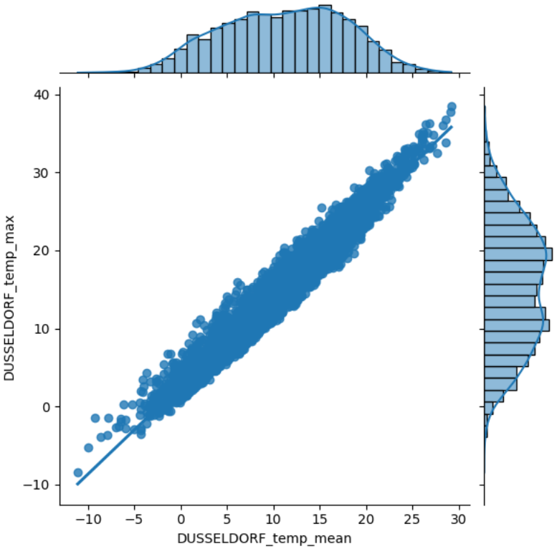
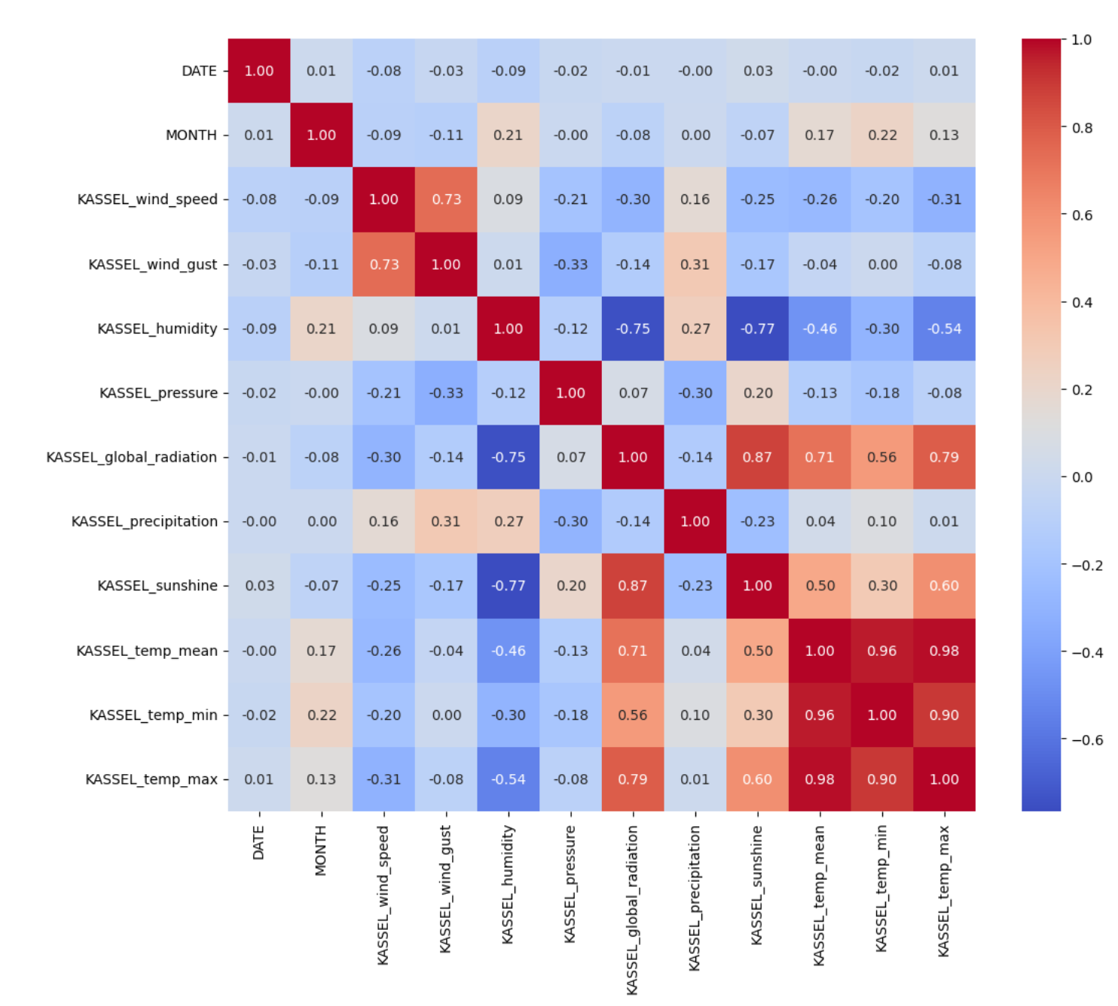
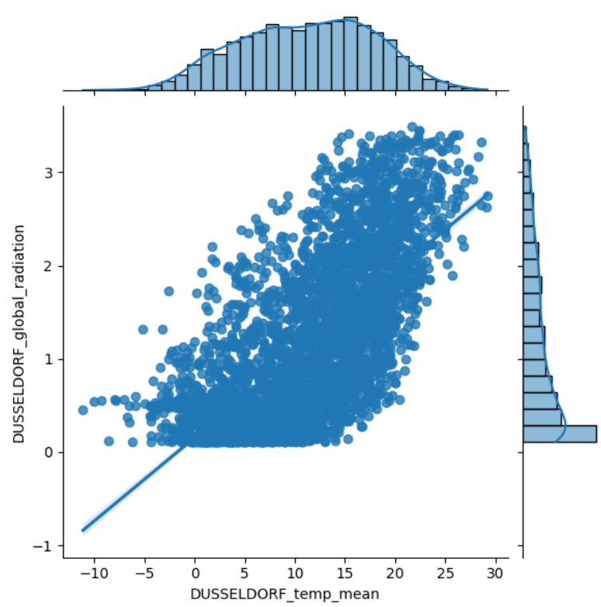
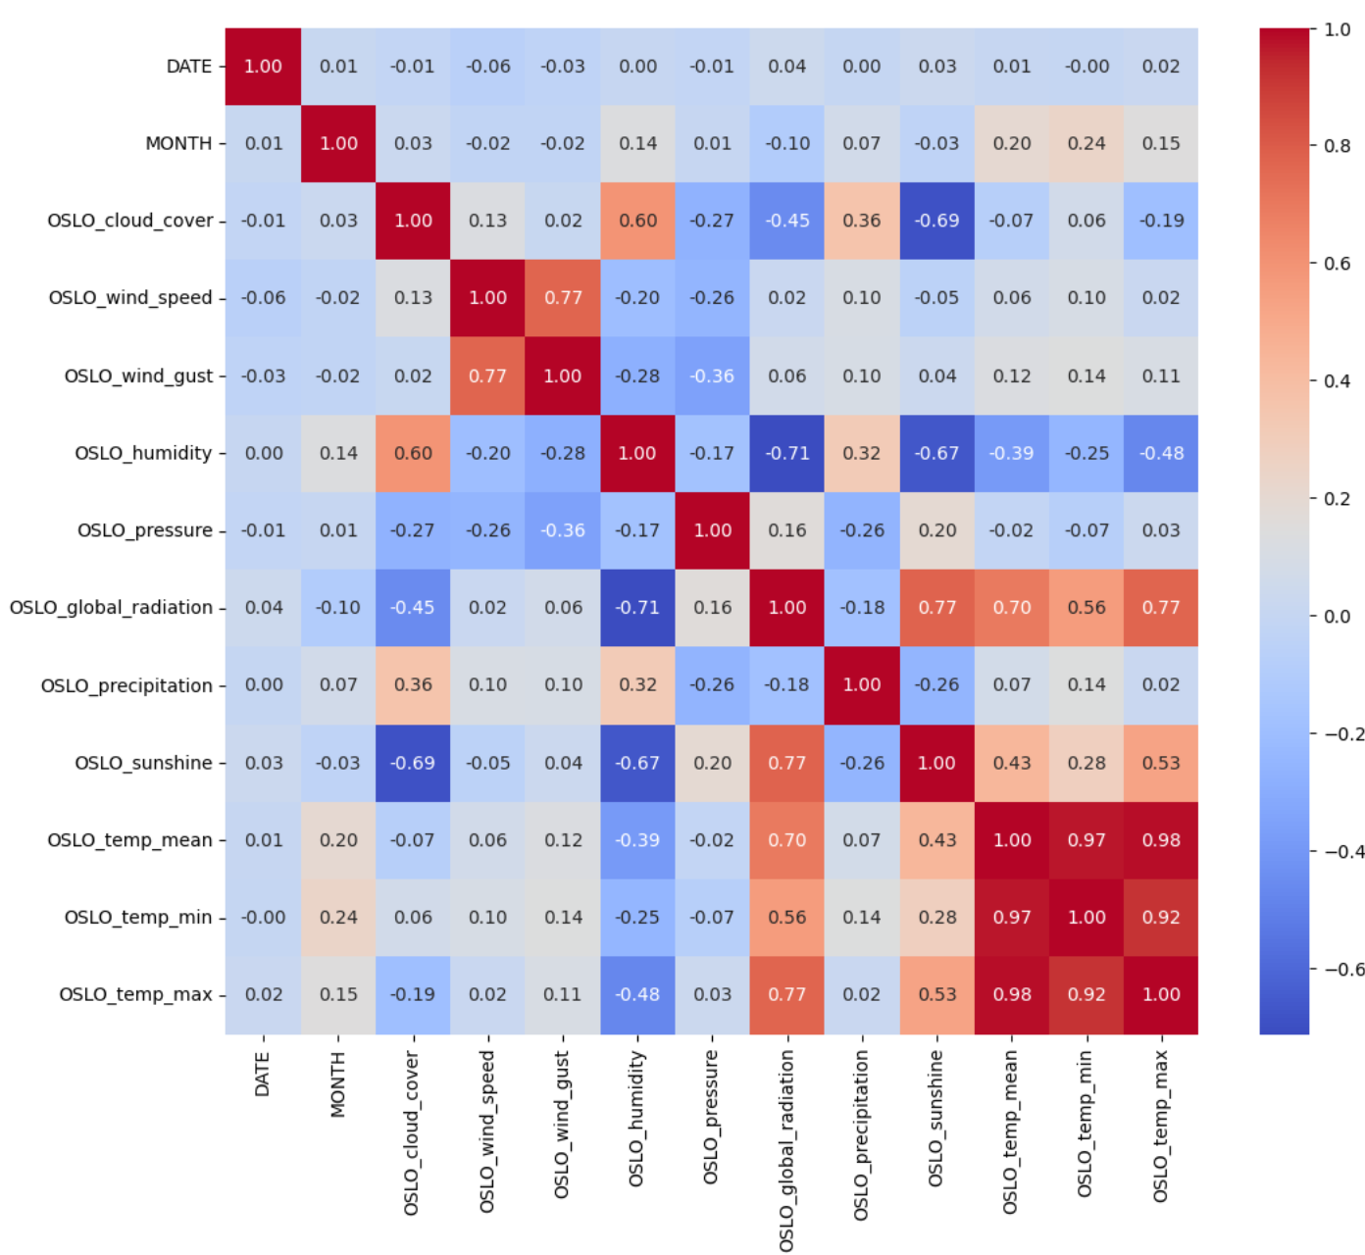
Data Wrangling and EDA
Data Wrangling –
Sorting by city and weather variable
imputing invalid values in dataset
EDA –
Heatmaps, find correlation
Scatterplots, search for best predictors
Notes:
Going through the actions taken and challenges at each step of the Data Science Method, it started with data wrangling. Fortunately, there were no missing values in the initial dataset, and after breaking down the dataset into sub datasets sorted by weather metric, I was able to impute any invalid values with the appropriate minimum boundaries. For example, air pressure should never be negative, this was replaced with the minimum pressure values present at each location.
During the exploratory data analysis phase, heatmaps for all the cities were constructed to determine the best potential features for predicting the mean temperature. For the variables that showed significant correlation (such as the other temperature values, radiation levels, sunshine, and humidity), scatterplots were graphed out to visualize how correlated the data points were relative to a line of best fit.

Slide 10
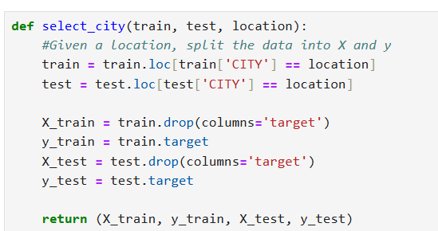
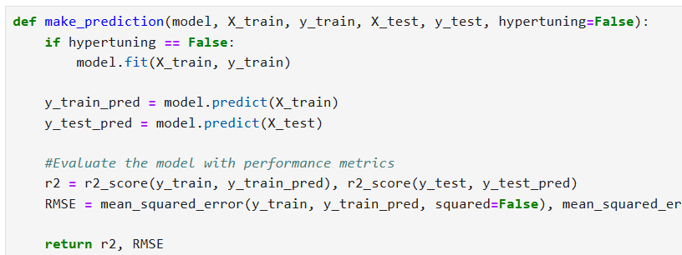
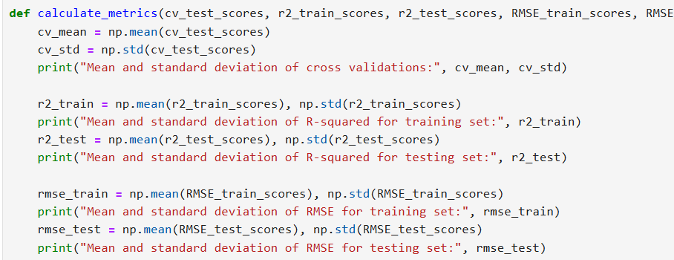
Preprocessing and Modeling
Preprocessing –
Restructuring of columns – no longer specific to each city
Functions to streamline modeling phase
Choosing top 2 candidates for optimization
Modeling –
Hyperparameter tuning of top 2 models
Saving finalized models to file
Notes:
During the start of preprocessing, the dataframe was reshaped so that instead of each weather variable having a column specific to each city, a new city column was created so that each distinct variable only required one column. This greatly reduced the width of the dataframe, or number of columns. Afterwards, several functions were constructed to streamline the model building and evaluating process, where given a set of parameters, a model type would be selected, multiple instances would be built, fitted, and evaluated specific to each location. The results of all the metrics would then be stored in lists to determine the best models.
From there, the 2 best models then underwent hyperparameter tuning to optimize each one’s accuracy. They happen to be CatBoost and LightGBM. The optimized models were then saved and stored in separate folders in the same repository.

Slide 11
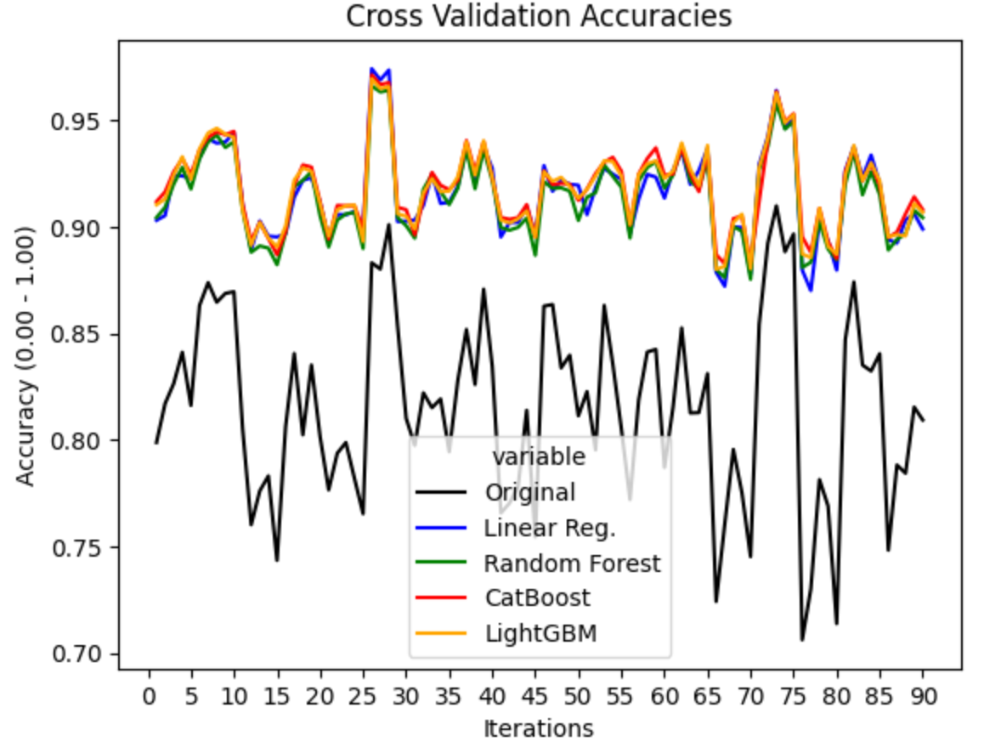
Performance Across Models
Accuracies of the original model alongside multiple candidates for the new replacement model across different iterations of cross validation.
Models
Notes:
Here is a graph comparing the cross validation scores, or simply accuracies of multiple models, including the original, the 2 new models, and a couple models that didn’t make the final cut.

Slide 12
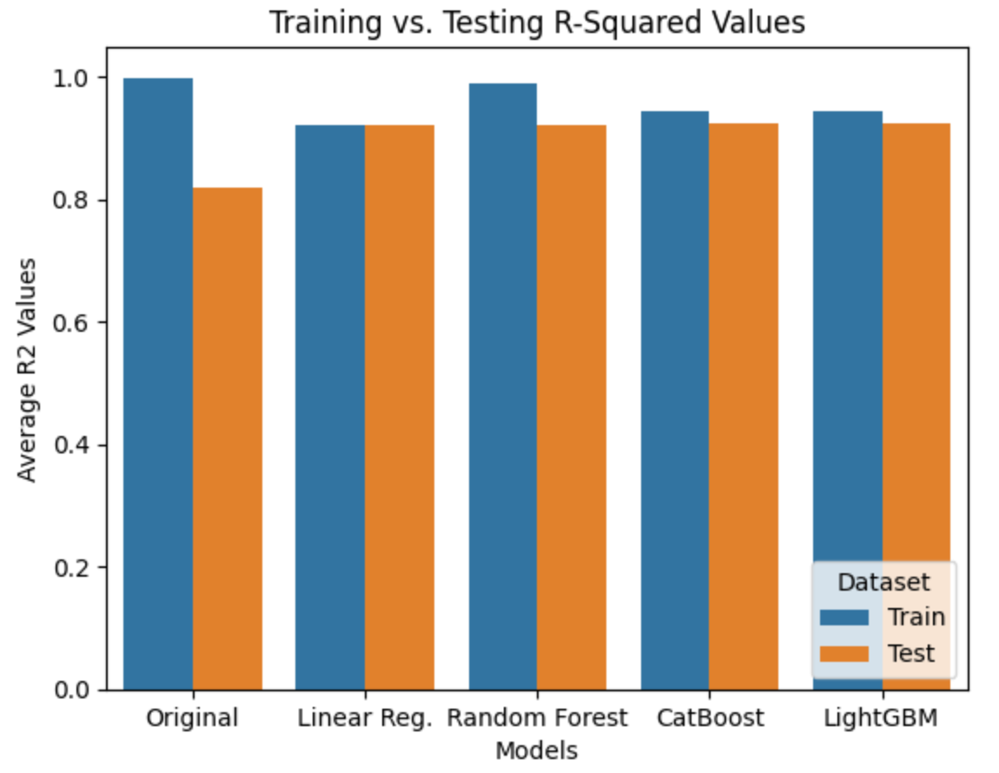
Overfitting Across Models
Comparison of training vs testing R-squared scores across all the models.
Notes:
This bar chart compares the training vs testing dataset R-squared values, or a metric for determining a model’s accuracy for all the models that were experimented with.

Slide 13
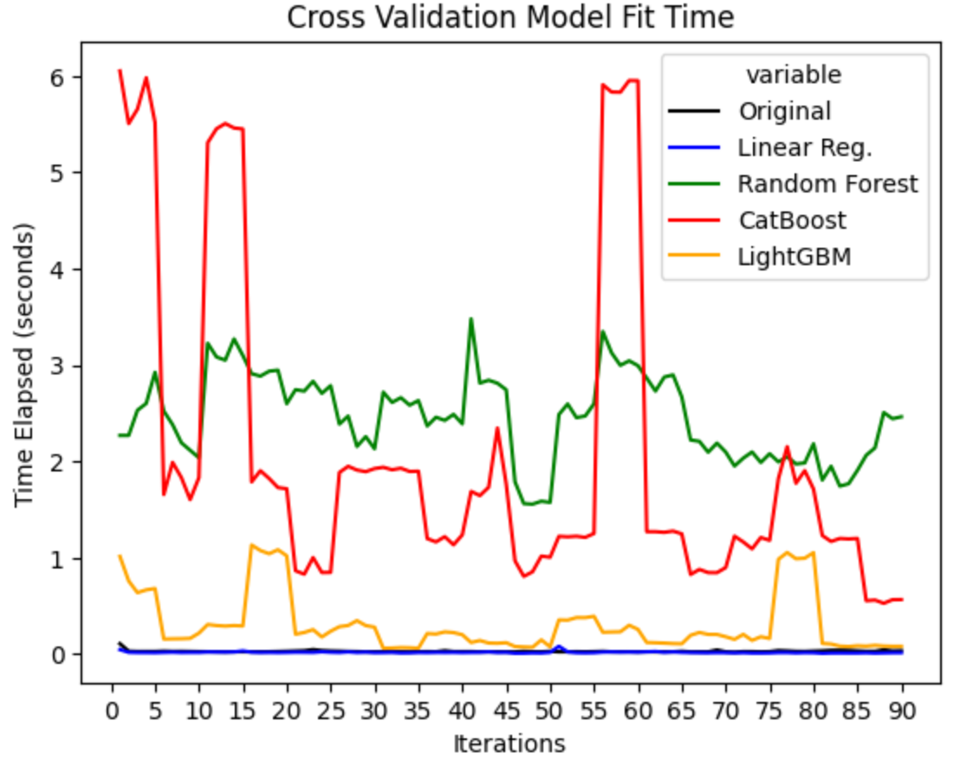
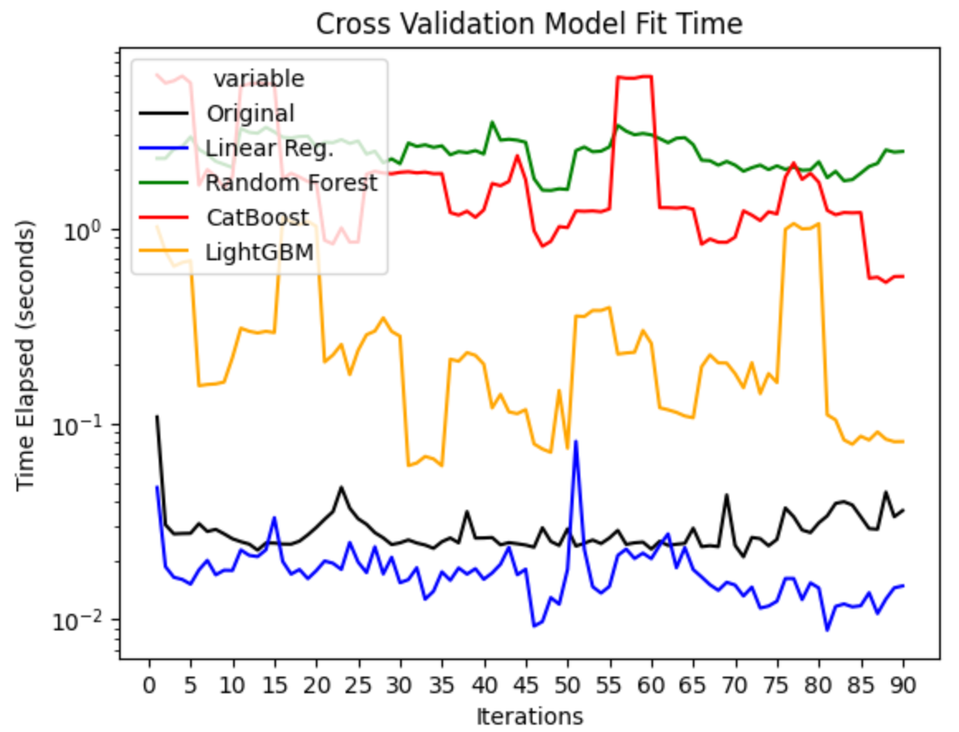
Training Time Across Models
Training time comparison across all models
Training time comparison across all models (logarithmic scale)
Models
Models
Notes:
These line plots show the training time taken in seconds for all the models. The left is a normal plot while the right is done where the time on the y-axis is on a logarithmic scale.

Slide 14
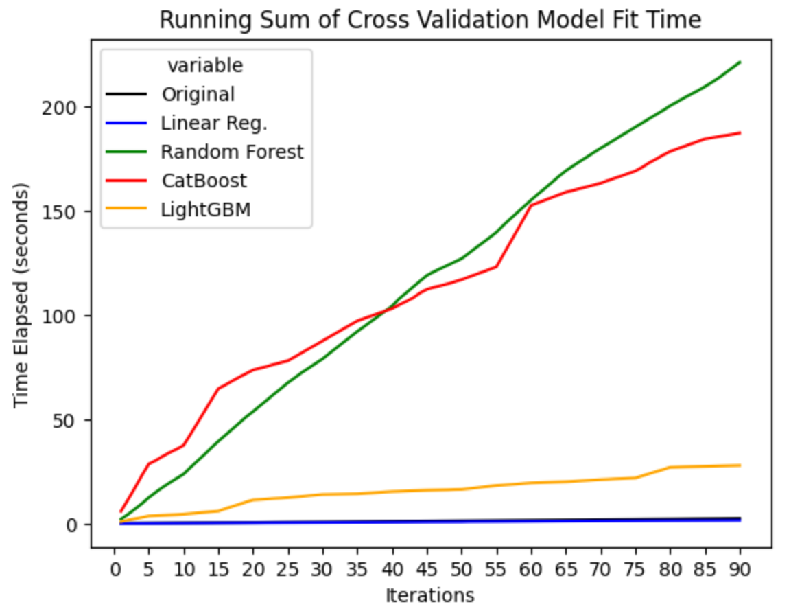
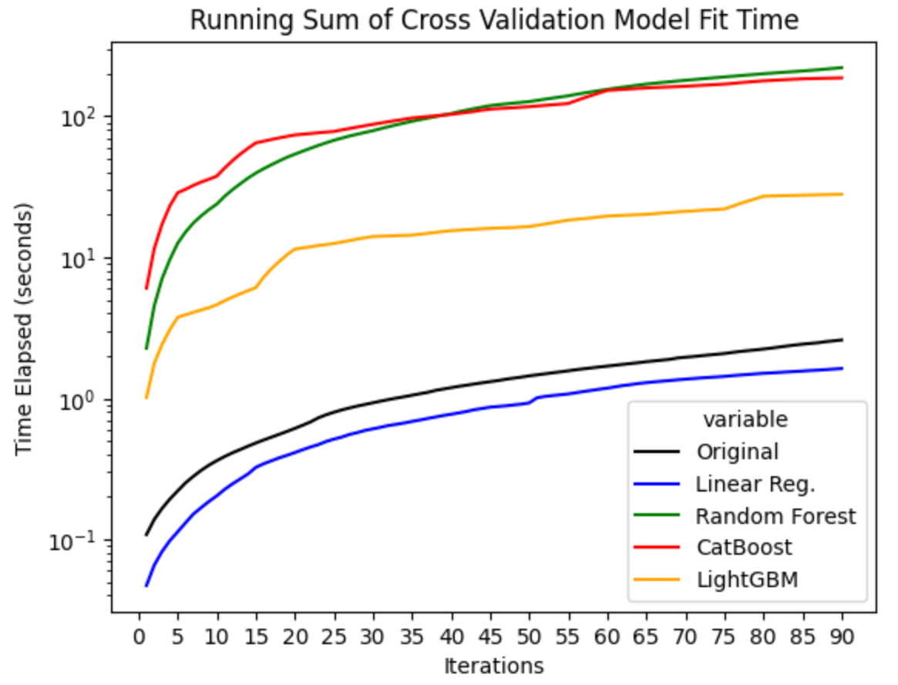
Running Sum of Training Time Across Models
Running sum of training time comparison across all models
Running sum of training time comparison (logarithmic scale)
Models
Models
Notes:
Staying of training time, these graphs show the running sum of time taken for training for all the models. The left is a normal plot while the right is done where the time on the y-axis is on a logarithmic scale.

Slide 15
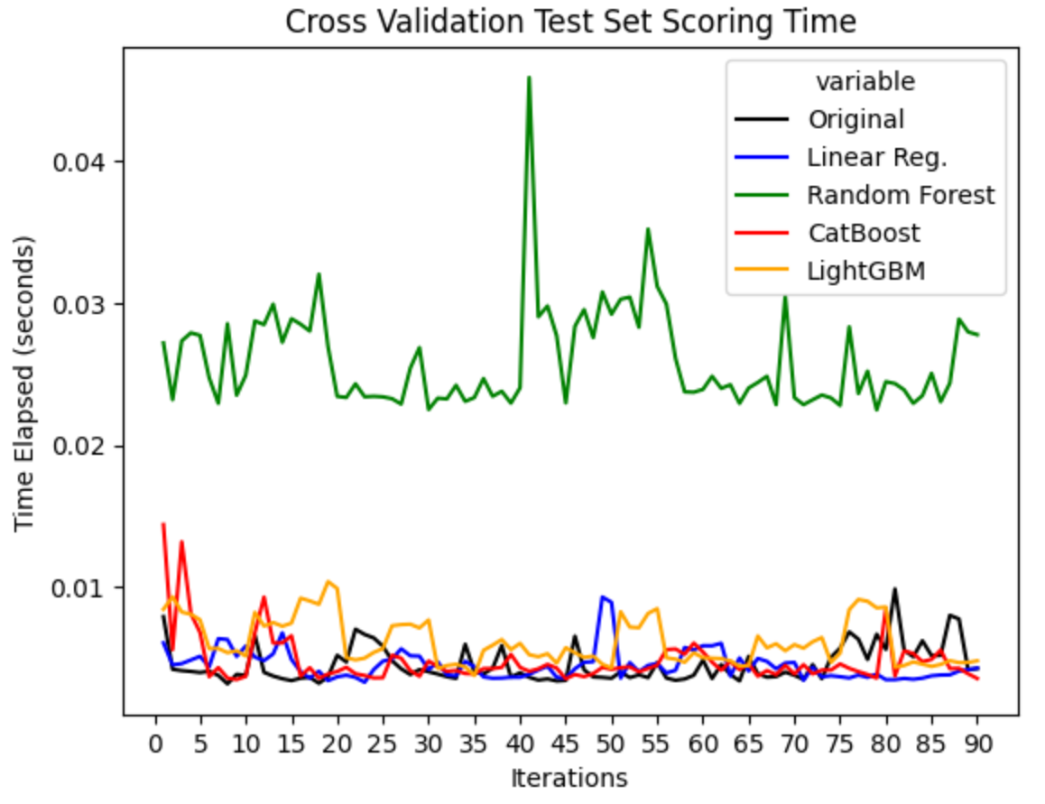
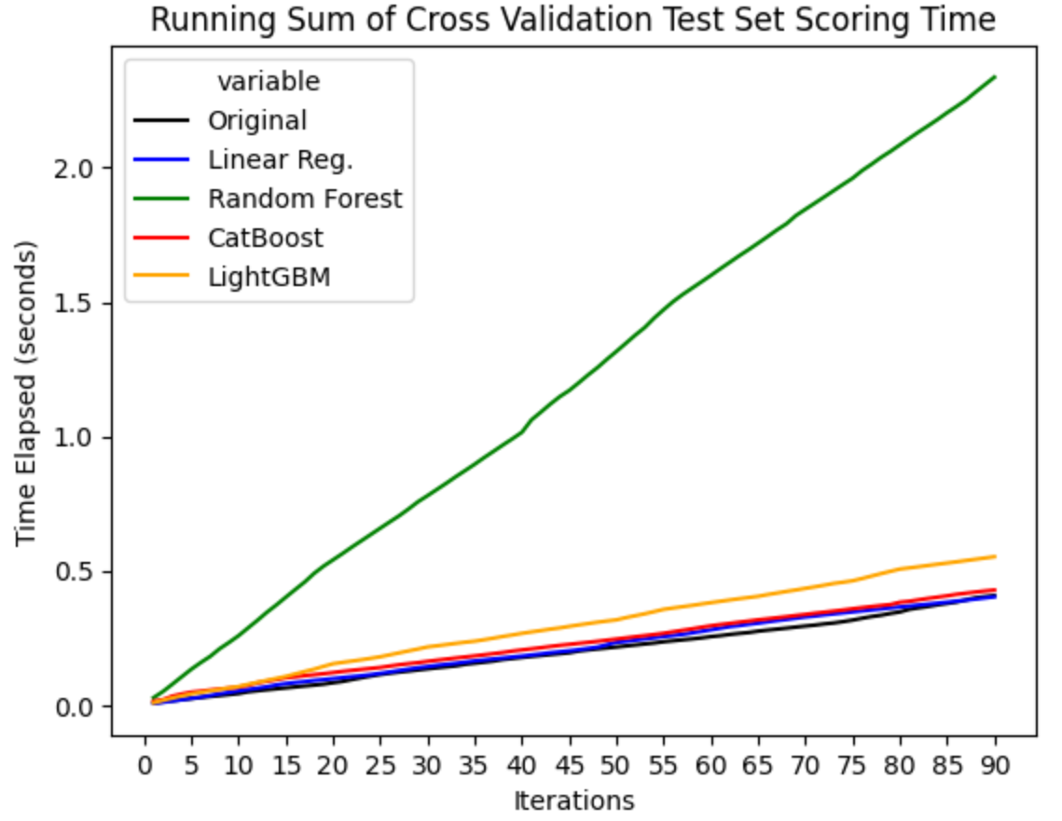
Scoring Time Across Models
Time taken to evaluate test scores across all the models
Running sum of time taken to evaluate test scores
Models
Models
Notes:
In a similar fashion, these line plots show the scoring time on the testing dataset taken in seconds for all the models. The left is a normal plot while the right is done where the time on the y-axis is on a logarithmic scale.

Slide 16
Additional Findings
XGBoost based model performed very poorly, worse than the original decision tree model, also suffered from significant overfitting.
Linear Regression assumes linearity between weather patterns, which isn’t always true.
Time series models can benefit more if it is necessary to make predictions of values further into the future.
Neural networks, though not explicitly tested as a potential model replacement, can be a viable candidate especially with very large datasets.
Future models where many locations of close proximity are included should also have a spatial awareness aspect to them.
Notes:
Though not shown in the graphs, XGBoost models were also tested, but they ended up yielding very poor accuracy scores, even worse than the stand-alone decision tree.
Linear regression, though it performed well in the analysis, assumes linearity between weather patterns, which is not always the case.
The decision to not use time series models for this analysis was that the labels being predicted by the models was the mean temperature of tomorrow at each location. If it is necessary to predict perhaps the next week or 14 days of temperature, a time series model could be more of use.
Outside of models dealing strictly with tabular data, neural networks can also be a strong alternative if the dataset eventually becomes massive, however they will require extensive hyperparameter tuning if intended to be deployed.
A final note would be future models can also consider geographic proximity, or have a spatial awareness factor to them when doing weather predictions, such as understanding the weather between London and Birmingham would be more correlated than between Madrid and Budapest.

Slide 17
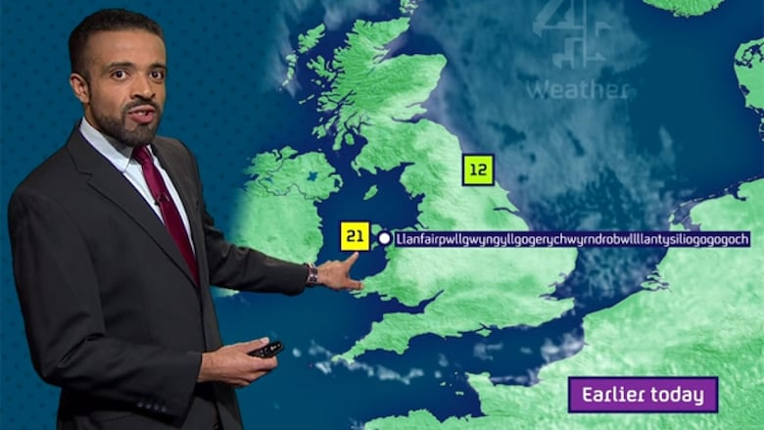
CONCLUSION
Replace current with CatBoost model
Have the LightBGM model ready as a backup

